Slide 1
Module-1
Data types
Operators and Expressions
Input and Output Statements
Control Structures
Selective and Repetitive structures

Slide 2

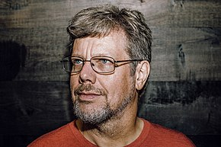
Introduction to Python
Created by Guido van Rossum.
First released in 1991.
Supports object-oriented programming with classes and multiple inheritance.
Comes with a large standard library.
Includes an Integrated development and Learning environment(IDLE).
Runs on Mac OS X, Windows, Linux as Freeware.

Slide 3
Python Features
Easy to Use:
Python is very easy to use and high level language. Thus it is programmer-friendly language.
Expressive Language:
Python language is more expressive. The sense of expressive is the code is easily understandable.
Interpreted Language:
Python is an interpreted language i.e. interpreter executes the code line by line at a time. This makes debugging easy and thus suitable for beginners.
Cross-platform language:
Python can run equally on different platforms such as Windows, Linux, Unix , Macintosh etc. Thus, Python is a portable language.

Slide 4
Python Features (contd…)
Free and Open Source:
Python language is freely available(www.python.org).The source-code is also available. Therefore it is open source.
Object-Oriented language:
Python supports object oriented language. Concept of classes and objects comes into existence.
Large Standard Library:
Python has a large and broad library.
GUI Programming:
Graphical user interfaces can be developed using Python.
Integrated:
It can be easily integrated with languages like C, C++, JAVA etc.

Slide 5
Limitations of Python
Difficulty in Using Other Languages
The Python lovers become so accustomed to its features and its extensive libraries, so they face problem in learning or working on other programming languages. Python experts may see the declaring of cast “values” or variable “types”, syntactic requirements of adding curly braces or semi colons as an onerous task.
Weak in Mobile Computing
Python has made its presence on many desktop and server platforms, but it is seen as a weak language for mobile computing. This is the reason very few mobile applications are built in it like Carbonnelle.

Slide 6
Limitations of Python (contd…)
Gets Slow in Speed
Python executes with the help of an interpreter instead of the compiler, which causes it to slow down because compilation and execution help it to work normally. On the other hand, it can be seen that it is fast for many web applications too.
Run-time Errors
The Python language is dynamically typed so it has many design restrictions that are reported by some Python developers. It is even seen that it requires more testing time, and the errors show up when the applications are finally run.
Underdeveloped Database Access Layers
As compared to the popular technologies like JDBC and ODBC, the Python’s database access layer is found to be bit underdeveloped and primitive. However, it cannot be applied in the enterprises that need smooth interaction of complex legacy data.

Slide 7
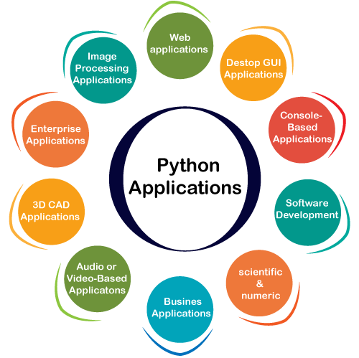
Python Applications

Slide 8
Representation of Data
Literal
Numeric Literal
String Literals
Variables
Identifiers
Operators
Arithmetic operators
Expressions and Data Types
Operator Precedence and Associativity
Data type
Mixed Type expressions

Slide 9
Numeric Literal
Has only digits 0 to 9, a sign character (+ or -) and a possible decimal point
Commas are not used
A numeric literal with a decimal point is a float (ex: 10.4) otherwise it is an integer value (ex: 10)
Types of Numeric Literals:
Integer
Floating point

Slide 10
Numeric Literal…..
Integer Values:
2500 + 2500 -2500
Floating Point Values:
5.0 0.0005 5000.125
2500. 2500.0 2500.125 +2500.
+2500.0 -2500. -2500.0 -2500.125

Slide 11
Numeric Literal…..
Invalid Numeric Literals:
5,000.125 2,500 2,500.125
+2,500 +2,500.125 -2,500
-2,500.125

Slide 12
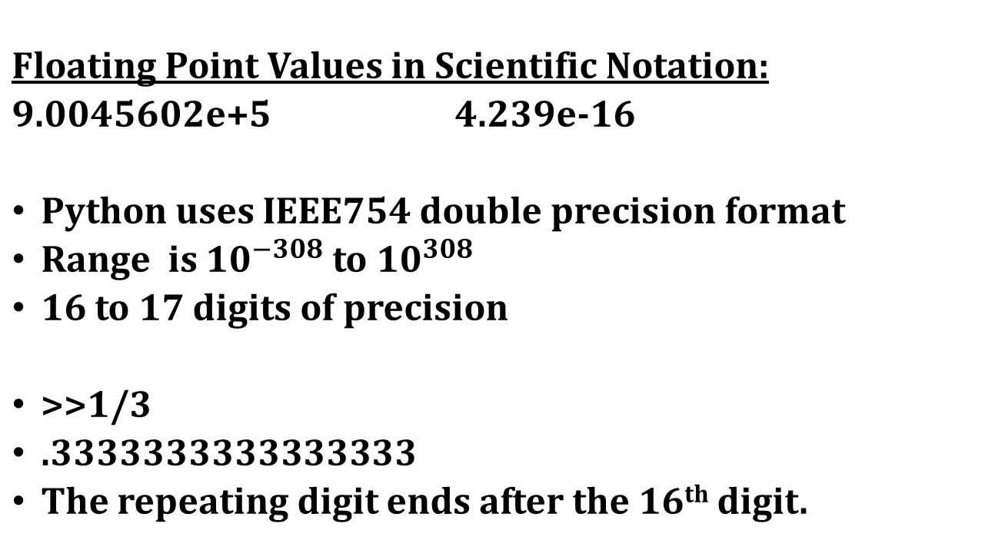
Numeric Literal…..

Slide 13
Representation of Data
String Literals
A sequence of characters within a pair of matching single or double quotes or triple quotes
Ex: ‘Hello’ ‘Smith, John’
“Baltimore, Maryland” ‘ ‘ ‘’
“Jennifer’s friend”
Convention is to use single quotes for delimiting strings
Type the following from the Spyder command prompt
>>>print(‘Hello’) ????? >>>print(‘Let’s Go’) ????
>>>print(“Hello’) ????? >>>print(“Let’s Go!’) ???
>>>print(“Let’s Go!”) ????

Slide 14
Mutable and immutable types
Some values in python can be modified, and some cannot.
This does not ever mean that we can’t change the value of a variable – but if a variable contains a value of an immutable type, we can only assign it a new value. We cannot alter the existing value in any way.
Integers, floating-point numbers and strings are all immutable types – in all the previous examples, when we changed the values of existing variables we used the assignment operator to assign them new values:

Slide 15
Variables
A variable is a name(identifier) that is associated with a value
num = 10
num = num + 5
k = num.
Integer values are immutable. A value that cannot be changed is known as immutable.
the same variable can be associated with values of different types during program execution
var = 12 integer
var = 12.45 float
var = ‘Hello’ string

Slide 16
Python Variables
Variable is a name which is used to refer memory location. Variable also known as identifier and used to hold value.
In Python, we don't need to specify the type of variable because Python is a type infer language and smart enough to get variable type.
Variable names can be a group of both letters and digits, but they have to begin with a letter or an underscore.
It is recommended to use lowercase letters for variable name. Rahul and rahul both are two different variables.
sides = 4
print(type(sides) )
print( id(sides) )
Output
<class 'int'>
10915392

Slide 17
Multiple Assignment
a = b = c = 1
a,b,c = 1,2,”john”
print(a,b,c)
x1,y1 = 2,3 # point one
x2,y2 = 6,8 # point two
m,b = float(y1-y2)/(x1-x2), y1-float(y1-y2)/(x1-x2)*x1
print ("y=",m,"*x+",b)
Try the above code

Slide 18
An identifier
An identifier is a sequence of one or more characters used to name a given program element
may contain letters and digits, but cannot begin with a digit.
The only special character allowed in an identifier is underscore.
An identifier starts with a letter A to Z or a to z or an underscore (_) followed by zero or more letters, underscores and digits (0 to 9).
Does not allow punctuation characters such as @, $, and % within identifiers.
Python is a case sensitive programming language.
Ex: ‘Python_Language’ and ‘python_language’ are different identifiers.

Slide 19
When we write a Python program, we will create many entities –
Variables which store values like numbers or strings
Functions
Classes etc..
These entities must given names by which they can be referred to uniquely – these names are known as identifiers
Syntax error | Bad practice, may correct | Good practice
Person Record | PRcrd | PersonRecord
DEFAULT-HEIGHT | Default_Ht | DEFAULT_HEIGHT
class | Class | AlgebraCourse
2totalweight | num2 | total_weight

Slide 20
Syntax error | Reason
Person Record | Identifier contains a space.
DEFAULT-HEIGHT | Identifier contains a minus.
class | Identifier is a keyword.
2totalweight | Identifier starts with a number.

Slide 21
Indentation and (lack of) semicolons and curly braces
Many languages arrange code into blocks using curly braces - { and } or BEGIN and END statements – these languages encourage us to indent blocks to make code easier to read, but indentation is not compulsory.
Python uses indentation only to delimit blocks, so we must indent our code
if (a<b) :
print(“b greater than a") # this is inside the block
b=b+1
print(“this is outside if“) # this is outside the block!

Slide 22
The following Python program is not indented correctly. Re-write it so that it can indent correctly.
if day == "monday":
return “M"
if day != "monday":
return “S"
#The correctly indented code is
if day == "monday":
return “M"
if day != "monday":
return “S"

Slide 23
Data Types in Python
Everything in Python programming is an object, and each object has its own unique identity(a type and a value).
There are many native(built-in) data types available in Python.
Numbers: An are integers( int) such as 1, 2, 3, float such as 2.6, 4.8 , fractions such as ½. ¾ and even complex numbers. There is no 'long integer' in Python 3.
Example: a=9 # a is a variable of type int.
b=43.7 # b is a variable of type float
bytes
x = bytes(5)
Boolean: Holds either true or false values.
print(10 > 9) print(10 == 9)

Slide 24
Data Types available in Python
Sequences
Strings: Sequence of Unicode characters.
s=‘apple’ # s is a variable of type ‘str’,
num=‘234’ # num is a variable of type ‘str’, check print(type(num))
Lists: An ordered mutable sequence of values.
L=[2,4,5] # L is a variable of type list. print (L) and check
L1=[‘you’, ‘me’, 3] # L1 is a variable of type list
Tuples: An ordered immutable sequence of values.
x = ("apple", "banana", "cherry") #print (x) and check

Slide 25
Sets: An unordered container of values, mutable
st = {"apple", "banana", "cherry"}
Dictionaries: A key-value pair set in an unordered way, mutable
Because Python is a pure object-oriented programming language, so other data types are also available.
d = { "brand": "Ford", "model": "Mustang", "year": 1964 }
Module- a module to be the same as a code library. A file containing a set of functions you want to include in your application
Eg.
import math # mandatory >>>math.pi 3.141592653589793
>>>math.exp(10) 1.0
>>>math.pow(2,4) 16.0 >>>2**4 16
>>>math.sqrt(4) 2

Slide 26
Variable Assignment and Keyboard Input
>>>name = input(‘What is your name?’)
print(“Entered name is”,name)
What is your name? ‘Jennifer’
The string Jennifer is assigned to name
The input function returns all inputs as strings.
For numeric inputs, the response of the input() must be converted to appropriate type.
age = int(input(‘What is your age?’))
gpa = float(input(‘What is your gpa?’))

Slide 27
Variable Assignment and Keyboard Input
Try the following
>>>name=input(‘What is your name’)
>>>name
????
>>>age = int(input(‘What is your age’))
>>>age
???

Slide 28
Keywords in Python
A keyword is an identifier that has a predefined meaning in a programming language
cannot be used as a regular identifier.
Table 2.2 shows list of Keywords available in Python
To check whether a given identifier is a keyword or not
>>>’int’ in dir(__builtins__)
Output : True
>>>’exit_program’ in dir(__builtins__)
Output : False

Slide 29
Another way of checking for keywords is
import keyword
keyword.iskeyword('int')
ex:
keyword.iskeyword('if') Out[11]: True keyword.iskeyword('yield') Out[12]: True keyword.iskeyword('exit') Out[13]: False //exit is not a keyword

Slide 30
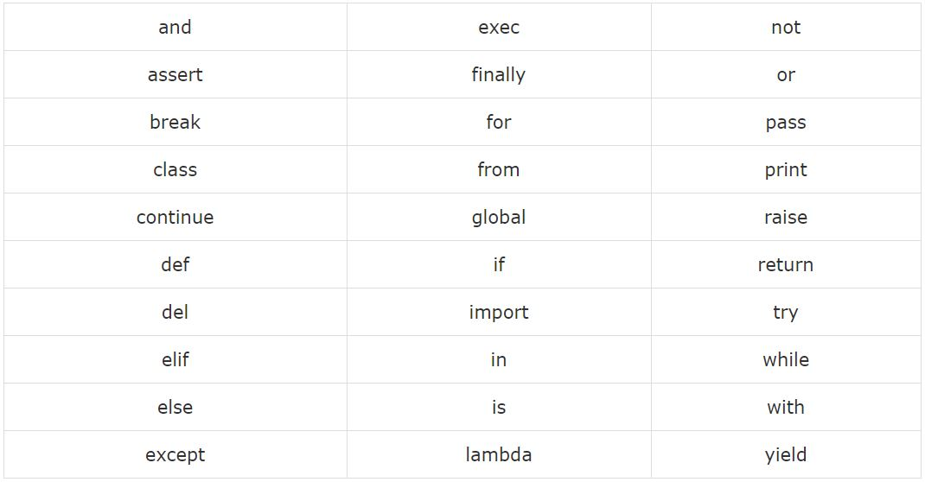
Reserved Words
All the Python keywords contain lowercase letters only.

Slide 31
Operators
Unary and binary arithmetic operators
Arithmetic Operator | Meaning | Example | Result
-x | negation | -10 | -10
x + y | addition | 10 + 25 | 35
x – y | subtraction | 10 – 25 | -15
x * y | multiplication | 10 * 5 | 50
x / y | division | 25/10 | 2.5
x // y | truncating division/ floor division | 25 // 10 25// 10.0 | 2 2.0
x % y | modulus | 25 % 10 | 5
x ** y | exponentiation | 10 ** 2 | 100

Slide 32
Operators…..
Try the following
>>>10 = 35 ???? >>>4 ** 2 ???? >>>45//10.0 ?????
>>>-10 + 35 ???? >>>45/10 ???? >>>2025 % 10 ????
>>>4 * 2 ???? >>>45//10 ???? >>>2015//10 ????

Slide 33
Expressions
a combination of operands (or a single operand) with operators that evaluates to a value.
If it evaluates to a numeric value it is known as arithmetic expression
>>>(2+3) * 4 ???? >>>2 + (3 * 4) ?????
>>>2 + ((3 *4) – 8) ??? >>>2 + 3 * (4 – 1) ???

Slide 34
Mixed Type Expressions, Coercion and Type Conversion
It is an expression with operands of different types
In a mixed type expression either coercion(implicit) type conversion or explicit conversion takes place.
Ex : 2 + 4.5 is first implicitly converted (int converted to float) 2.0 + 4.5 which gives 6.5
Ex: float(2) + 4.5 is first explicitly converted 2.0 + 4.5 which gives 6.5
2 + int(4.5) gives 2 + 4 which is 6

Slide 35
Program -1
Write a program to convert the given temperature in Fahrenheit to Celsius
#Temperature Conversion
f = float(input(‘Enter the Fahrenheit temperature’))
c = (f – 32) * 5.0 / 9
print ‘Celsius Temperature is’, c

Slide 36
Program -2
Read three numbers and print their sum
num1 = int(input('Enter first number'))
num2 = int(input('Enter Second number'))
num3 = int(input('Enter Third Number'))
sum = num1 + num2 + num3
print('Sum=', sum)
Input: 23 34 45
Output: Sum=102

Slide 37
Program -3
# area of a triangle from its sides
import math
a = int(input('Enter side 1'))
b = int(input('Enter side 2'))
c = int(input('Enter side 3'))
s = float(a+b+c)/2
area = math.sqrt(s*(s-a)*(s-b)*(s-c))
print('Area = ', area)

Slide 38
Program -4
# Read a four digit binary number one digit at a time starting from the rightmost digit and print its decimal value
ones = int(input('enter the ones digit'))
sum = int(ones * (2 ** 0))
tens = int(input('enter the tens digit'))
sum = int(sum + tens *(2**1))
hund = int(input('enter the hundreds digit'))
sum = int(sum + hund *(2**2))
th = int(input('enter the thousands digit'))
sum = int(sum + th*(2**3))
print('sum = ', sum)

Slide 39
Program -5
# find x to the power y for some x and y
base = int(input('enter the base'))
exp = int(input('enter the exponent'))
print(base ** exp)

Slide 40
Program -6
# Roots of a quadratic equation ax**2 + bx + c = 0 given a,b and c
import math
a = float(input('Enter a'))
b = float(input('Enter b'))
c = float(input('Enter c'))
dis = (b**2) - (4*a*c)
root1 = (-b+ math.sqrt(dis))/(2*a)
root2 = (-b-math.sqrt(dis))/(2*a)
print('Root 1 ', root1)
print('Root2 ', root2)

Slide 41
Program -7
# pgm to add two real numbers and print their sum using format function
num1 = float(input('enter first number'))
num2 = float(input('enter second number'))
sum = num1 + num2
print('The sum of {0} and {1} is {2}'.format(num1,num2,sum))

Slide 42
Program -8
#swap two given values
a = int(input('Enter a'))
b = int(input('Enter b'))
t = a
a = b
b = t
print('The value of a after swapping is {0}'.format(a))
print('The value of b after swapping is {0}'.format(b))

Slide 43
Program -9
# Generate a random number between 0 and 9
import random
print(random.randint(0,9))

Slide 44
Program -11
#Read the radius of a circle and find its area

Slide 45
Program -12
An object’s momentum is a product of its mass and velocity. Write a Python script to accept an object’s mass (in kilograms) and velocity (in metres per second) as inputs and output its momentum.

Slide 46
1. Arithmetic Operators
Operator | Meaning | a = 13, b = 5 | Result
+ | Addition Operator | a + b | 18
- | Subtraction Operator | a – b | 8
* | Multiplication Operator | a * b | 65
/ | Division Operator | a / b | 2.6
% | Modulus Operator | a % b | 3
** | Exponential Operator | a ** b | 13⁵ = 371293
// | Floor Division | a // b | Floor(2.6) = 2

Slide 47
2. Assignment Operators
Operator | Meaning | x = 20, y = 10, z = 5 | Result
= | z = x + y | z = 20 + 10 | 30
+= | z += x => z = z + x | z = 5 + 20 | 25
-= | z -= x => z = z – x | z = 5 – 20 | -15
*= | z *= x => z = z * x | z = 5 *20 | 100
/= | z /= x => z = z / x | z = 5 / 20 | 0.25
%= | z %= x => z = z % x | z = 5 % 20 | 5
**= | z **= x => z = z ** x | z = 5 ** 20 | 5²⁰
//= | z //= x => z = z // x | z = 5 // 20 | 0

Slide 48
3. Unary Minus Operators
This operator is used to change the sign of an operand.
num = -10
num = -num
print(num) #10

Slide 49
4. Relational Operators
Operator | Meaning | a = 13, b = 2 | Result
> | Greater Than | a > b | True
>= | Greater Than OR Equal To | a >= b | True
< | Less Than | a < b | False
<= | Less Than OR Equal To | a <= b | False
== | Equal To | a == b | False
!= | Not Equal To | a != b | True

Slide 50
5. Logical Operators
Operator | Meaning | x = 100, y=20, z=0 | Result
and | x and y | x > y and y < z | False
or | x or y | x > y or y < z | True
not | not x | not z | True

Slide 51
6. Boolean Operators
Boolean Operator acts upon ‘bool’ type literals.
Operator | Meaning | x = True, y = False | Result
and | Boolean And Operator | x and y | False
or | Boolean Or Operator | x or y | True
not | Boolean Not Operator | not y | True

Slide 52
7. Membership Operators
Membership operators are useful to check for membership in a sequence (strings, lists, tuples, dictionaries)
‘in’ Operator: This operator returns ‘True’ if element found in the sequence.
‘not in’ Operator: This operator returns ‘True’ if element not found in the sequence.

Slide 53
Example:
x = [1,2,3,4,5]
for num in x:
print(num)
x = {‘a’ : ’Apple’, ‘b’ : ’Ball’, ‘c’ : ’Cat’}
for alpha in x:
print(x[alpha])

Slide 54
8. Identity Operators
These operators are used to compare the memory locations of two objects. id() function is used to check the memory location of an object.
‘is’ Operator: This operator will compare the identity of two variables and return ‘True’ if they are same object.
‘is not’ Operator: This operator also will compare the identity of two variables and return ‘True’ if they are not the same object.

Slide 55
Example:
a = 25
b = 25
if a is b:
print(“Have same ID”);
else:
print(“Different ID”);
a = 25
b = a
if a is not b:
print(“Have different ID”);
else:
print(“Same ID”);
#Have same ID
#Same ID

Slide 56
Control Structures
Programming language provides 3 fundamental forms of control structures:
Sequential: Instructions are executed in the form they are written. No jump of control.
Selective: Control statement that selectively executes the instructions and may have jump of control within program.
if
if – else
if-elif-else

Slide 57
C. Iterative: Control statements that can execute a particular set of statements in a loop and terminates based on the given conditions.
while
for
else suite
break
continue
pass
assert
return

Slide 58
Sequential Control Statements
a = 10
b = a
print(“ a = b ”)
Indentation in Python: Indentation refers to the space that are used in the beginning of a statement.
Statements within the same indentation belongs to the same group called suite.
Note: By default, Python uses 4 spaces for indentation.

Slide 59
Selective Control Statements
2. ‘if’ statement:
syntax:
if condition:
statements
Example:
str = ‘Yes’
if str == ‘No’:
print(“No”)
print(“I’m in if block”)
print(“Demo Program”)
num = 1
if num == 1:
print(“one”)

Slide 60
Selective Control Statements
Nested ‘if’ statement:
Example:
vehicle = 1
type = ‘car’
c = ‘BMW’
b = ‘Honda’
if vehicle:
if type == ‘car’:
if c == ‘BMW’:
print(“we have a vehicle and it’s a BMW car”)
if type == ‘bike’:
if b == ‘Honda’:
print(“we have a vehicle and it’s a Honda bike”)

Slide 61
Selective Control Statements
2. ‘if - else’ statement:
syntax:
if condition:
statements
else:
statements
Example:
vehicle = ‘car’
if vehicle == ‘bike’:
print(“Riding a bike”)
else:
print(“Riding a car”)

Slide 62
Selective Control Statements
2. ‘if – elif - else’ statement:
syntax:
if condition:
statements
elif condition:
statements
else:
statements
Example:
x = int(input(“Enter any number”))
If x >= 90:
print(“Grade - A”)
elif x >= 80:
print(“Grade - B”)
elif x >= 70:
print(“Grade – C”)
else:
print(“Outstanding”)

Slide 63
Program – 1
Write a python program to determine a number is even or odd.
x = int(input(“Enter any number”))
if x%2 == 0:
print(“Even number”)
else:
print(“Odd number”)

Slide 64
Program – 2
Write a python program to know whether an input number is positive, negative or zero.
x = int(input(“Enter any number”))
if x<0:
print(“Negative number”)
elif x>0:
print(“Positive number”)
else:
print(“Zero”)

Slide 65
Program – 3
Read two numbers num1 and num2 and find the largest of two.
num1 = int(input(“Enter num1”))
num2 = int(input(“Enter num2”))
if num1 > num2:
print(“num1 is greater than num2”)
elif num1 < num2:
print(“num2 is greater than num1”)
else:
print(“num1 and num2 are equal”)

Slide 66
Program – 4
Read a character A or B or C.
If the character input is A, program should print ‘Apple’;
if character entered is B, program should print ‘Banana’;
if character entered is C, program should print ‘Coconut
ch = input(“Enter the option”)
if ch == ‘A’:
print(“Apple”)
elif ch == ‘B’:
print(“Banana”)
elif ch == ‘C’:
print(“Coconut”)
else:
print(“Invalid option”)

Slide 67
Program – 5
Read three numbers and find the largest of three.
num1 = int(input(“Enter num1”))
num2 = int(input(“Enter num2”))
num3 = int(input(“Enter num3”))
If num1 > num2:
if num1 > num3:
print(“num1”,end = “ ”)
else:
print(“num3”,end = “ ”)
else:
if num2 > num3:
print(“num2”,end = “ ”)
else:
print(“num3”,end = “ ”)
print(“ is the largest value”)

Slide 68
Program – 5
Write a Python script that reads the numeric grade of a student and print its equivalent letter grade as given below:
Letter Grade | Range of Numeric Grades
A | All grades above 89
B | All grades above 79 and below 90
C | All grades above 69 and below 80
F | All grades below 70
G= int(input(“Enter Grade”))
if G > 89:
print(“A”)
elif G > 79 and G < 90:
print(“B”)
elif G > 69 and G < 80:
print(“C”)
else:
print(“F”)

Slide 69
Program – 7
Write a Python script to read the length and breadth of a rectangular garden in centimeters. The program should also find the cost of fencing the garden, if the cost of fencing per cm Rs.168.
Program :
l = float(input("enter the length of the garden"))
b = float(input("enter the breadth of the garden"))
p = 2 * (l + b)
cost = p * 168
print('Perimeter of the garden is', p)
print('Cost of fencing the garden is', cost)
Sample Input and Output:
enter the length of the garden 10
enter the breadth of the garden 5
Perimeter of the garden is 30.0
Cost of fencing the garden is 5040.0

Slide 70
Program – 8
Write a Python script to read the name and age of two persons x and y.
The program should also print the younger of the two.
Sample Input :
Name : David Age : 67
Name: Jennifer Age : 32
Output:
Jennifer is the youngest
Program:
name1 = input("Enter the name of first person")
age1 = int(input("Enter the age of first person"))
name2 = input("Enter the name of second person")
age2 = int(input("Enter the age of second person"))
if age1<age2:
print(name1, "is the youngest")
else:
print(name2, "is the youngest")

Slide 71
Program – 9
Write a Program to read the three sides of a triangle and check whether it is Equilateral, Isosceles or Scalene Triangle
Program:
a = int(input("Enter the first side"))
b = int(input("Enter the second side"))
c = int(input("Enter the third side"))
if ((a == b) and (a == c)):
print("Equilateral")
elif ((a == b) or (b == c) or (c == a)):
print("Isosceles Triangle")
else:
print("Scalene Triangle")

Slide 72
Program – 11
Write a Python script to read a character and check whether it is an alphabet, digit or a special character.
Program:
c = input("Enter a character")
x = ord(c)
if (x >= 65 and x<= 90):
print("is an alphabet")
elif ( x>=48 and x<=57):
print("digit")
else:
print( c,"is special character")

Slide 73
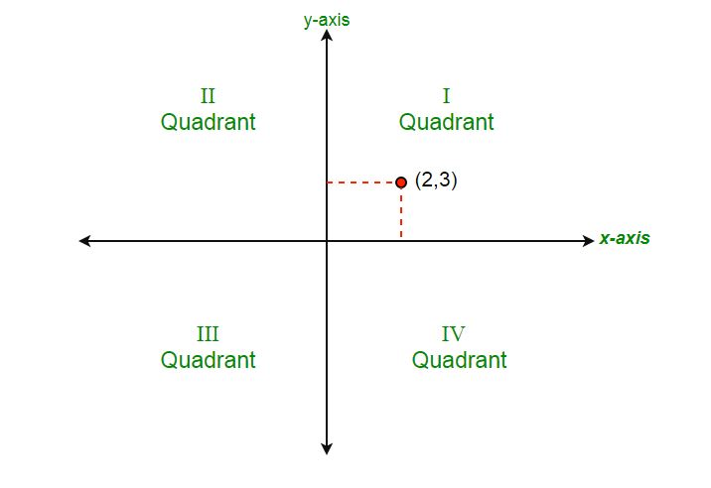
Program – 11
Write a Python script to read the x and y co-ordinate of a point (x, y) and find the quadrant in which the point lies as given below
Condition | Quadrant
x is positive, y is positive | First
x is negative, y is positive | Second
x is negative, y is negative | Third
x is positive, y is negative | Fourth

Slide 74
x=0
y=0
if (x > 0 and y > 0):
print ("lies in First quadrant")
elif (x < 0 and y > 0):
print ("lies in Second quadrant")
elif (x < 0 and y < 0):
print ("lies in Third quadrant")
elif (x > 0 and y < 0):
print ("lies in Fourth quadrant")
elif (x == 0 and y > 0):
print ("lies at positive y axis")
elif (x == 0 and y < 0):
print ("lies at negative y axis")
elif (y == 0 and x < 0):
print ("lies at negative x axis")
elif (y == 0 and x > 0):
print ("lies at positive x axis")
else:
print ("lies at origin")

Slide 75
Iterative Control Structures
while loop
for loop
range function
break statement
continue statement
PASS statement

Slide 76
While Loop
Syntax
while condition:
suite (Statements within the same indentation belongs to the
same group called suite)
Definite loop
a program loop in which the number of times the loop will iterate can be determined before the loop is executed.
Indefinite loop
program loop in which the number of times the loop will iterate cannot be determined before the loop is executed.
Example
Find 1+2+3+…..+n, for a given n

Slide 77
Find 1+2+3+…..+n, for a given n
# this program finds 1+2+3+…..+n, for a given n
sum = 0
current = 1
n = int(input("Enter a value:"))
while current <= n:
sum = sum + current
current = current + 1
print("Sum=", sum)

Slide 78
Program – 10
Write a Python script to read a three digit number and find the sum of the cubes of the individual digits.
# take input from the user
num = int(input("Enter a number: "))
# initialize sum
sum = 0
# find the sum of the cube of each digit
temp = num
while temp > 0:
digit = temp % 10
sum += digit ** 3
temp //= 10
print(sum)

Slide 79
for Loop in python
for loop in Python is used to iterate over a sequence (list, tuple, string) or other iterable objects.
Iterating over a sequence is called traversal.
Syntax:
for val in sequence:
suite

Slide 80
range()
Used to generate a sequence of numbers range(n)= 0 to n-1
range(10) will generate numbers from 0 to 9 (10 numbers)
Can define the start, stop and step size as range
Default step size is 1
All numbers generated are not stored in memory
>>> range(10)
range(0, 10)

Slide 81
List()
To display all the numbers generated by range()
>>> list(range(10))
[0, 1, 2, 3, 4, 5, 6, 7, 8, 9]
>>> list(range(2,8))
[2, 3, 4, 5, 6, 7]
>>> list(range(2,20,3))
[2, 5, 8, 11, 14, 17]

Slide 82
Using range() in for loop
range() is also used in for loop to iterate over a sequence of numbers
Example
n = int(input('Enter a number'))
for i in range(1,n+1):
print(i)
Enter a number 3
1
2
3
>>>

Slide 83
Program – 1
Program to read ‘n’ numbers and count positive, negatives and zeros among them.
np = 0
nn = 0
nz = 0
counter = 1
n = int(input('Enter the total no. of numbers'))
while counter <= n:
counter = counter + 1
num = int(input('Enter a number'))
if num < 0:
nn = nn + 1
elif num > 0:
np = np + 1
else:
nz = nz + 1
print('Positive count is {0}\n Negative count is {1}\n Zeros are {2}'.format(np,nn,nz))

Slide 84
Program – 2
Find the factorial of a given number n using for loop
fact = 1
n = int(input('Enter a number'))
if (n == 0) or (n == 1):
fact = 1
print('Factorial is ', fact)
else:
for i in range(1,n +1):
fact = fact * i
print('Factorial is ', fact)

Slide 85
Program – 3
Check whether a given number is prime or not
flag = 1
num = int(input('Enter a number'))
for i in range(2,num//2 +1):
if num % i == 0:
flag = 0
break
if flag == 0:
print('Not prime')
else:
print('Prime')

Slide 86
Program – 4
Check whether a given number is a perfect number or not
sdiv = 0
n = int(input('Enter a number'))
for i in range(1,n//2 +1):
if n % i == 0:
sdiv = sdiv + i
if n == sdiv:
print('Perfect number')
else:
print('Not a perfect number')

Slide 87
Program – 5
Check whether a given number is an armstrong number or not
scubes = 0
n = int(input('Enter a number'))
num = n
while n != 0:
digit = n % 10
scubes = scubes + digit ** 3
n = n//10
if (scubes == num):
print('The number {0} is an armstrong number'.format(num))
else:
print('The number {0} is not an armstrong number'.format(num))

Slide 88
Program – 6
Program to print all prime numbers within a particular interval
lower = int(input("Enter lower range: "))
upper = int(input("Enter upper range: "))
print("Prime numbers between {0} and {1} are:".format(lower,upper))
for num in range(lower,upper + 1):
# prime numbers are greater than 1
if num > 1:
for i in range(2,num):
if (num % i) == 0:
break
else:
print(num)

Slide 89
Program – 7
Multiplication table of a given number.
n = int(input('Enter a number'))
for i in range(1,10+1):
print("{0} * {1} = {2}".format(n,i,n*i))

Slide 90
Program – 8
Print first n terms of the fibonacci series.
a = 0
b = 1
n = int(input('enter the number of terms'))
if n == 1:
print(a)
elif n == 2:
print("{0} \n{1}".format(a,b))
else:
print("{0} \n{1}".format(a,b))
count = 2
while(count < n):
c = a + b
print(c)
count = count + 1
a = b
b = c

Slide 91
Exercise Programs
Quick learners contact your instructor for level 2 programs and start doing. Then share your colab with instructor

Slide 92
1. Write a Python program to read a cat’s age in human years and calculate its equivalent cat’s age in cat years. Note: For the first two years, a cat year is equal to 10.5 human years. After that, each cat year equals 4 human years.
h_age = int(input("Input a cat's age in human years: "))
if h_age < 0:
print("Age must be positive number.")
exit()
elif h_age <= 2:
c_age = h_age * 10.5
else:
c_age = 21 + (h_age - 2)*4
print("The cat's age in cat's years is", c_age)

Slide 93
2. Rahul is an obedient son. His mother wants him to go to market and purchase some vegetables based on some conditions. Rahul decided to automate the price list based on the list given by his mother: Potato: purchase 5kg if price is <=20 otherwise purchase 1kg Tomato: purchase 2kg if price is <=40 otherwise purchase 1kg Onion: purchase 2kg if price is <=100 otherwise purchase 1kg Input: First three input are prices of vegetables which Rahul asks from shopkeeper Output: Quantity of each vegetable

Slide 94
p = int(input("Enter price of pta")) t = int(input("Enter price of tom")) o = int(input("Enter price of oni")) if p <= 20:
print("Buy 5kg")
else:
print("Buy 1kg")
if t <= 40:
print("Buy 2kg")
else:
print("Buy 1kg")
if o <= 100:
print("Buy 2kg")
else:
print("Buy 1kg")

Slide 95
3. Print the alphabets till z with given increment value, from given starting value Ex1: Input: inc val = 2 starting value = 'c' output: c e g i k m o q s u w y Input: inc val = 1 starting value = 'p' output: p q r s t u v w x y z
Solution:
inc = int(input("Enter the inc value"))
start = ord(input("Enter starting point"))
while start <= ord("z"):
print(chr(start),end = " ")
start += inc

Slide 96
4. Write a Python script to guess a number between 1 to 9.
import random
target_num, guess_num = random.randint(1, 10), 0
while target_num != guess_num:
guess_num = int(input('Guess a number between 1 and 10 until you get it right : '))
print('Well guessed!')

Slide 97
7. Write a Python program which iterates the integers from 1 to 50. For multiples of three print "THREE" instead of the number and for the multiples of five print "FIVE". For numbers which are multiples of both three and five print "THREEFIVE".
for i in range(1,50):
if i%3 == 0 or i%5 == 0:
if i % 3 == 0 and i % 5 == 0:
print(i,"THREEFIVE")
elif i % 3 == 0:
print(i,"THREE")
elif i % 5 == 0:
print(i,"FIVE")
else:
print(i)

Slide 98
8. Read a set of 4 bit binary numbers one bit at a time starting from MSB till the user input is 0000. For each input, the program should print whether it is divisible by 5 or not.
while (1):
b3,b2,b1,b0 = eval(input("Enter a 4-bit binary number one bit at a time from MSB"))
d = (b3 * (2**3)) + (b2 * (2**2)) + (b1*2) + b0
print("decimal equivalent is",d)
if d == 0:
break
else:
if ((d % 5) == 0) :
print("The number {0} is divisible by 5".format(d))
else:
print("The number {0} is not divisible by 5".format(d))

Slide 99
10. Write a Python script to read the number of digits in a given number and the digits one at a time. Convert the set of digits into a single decimal integer. Sample input : No. of digits : 5 Digits : 2,7,4,9,3 Output : 27493 = 2*10^4 + 7*10^3 + 4*10^2 + 9*10^1 +3*10^0
nd = int(input("Enter the number of digits"))
p = nd - 1
num = 0
for i in range(0, nd):
d = int(input("Enter a digit"))
num = num + (d * (10** p))
p = p - 1
print("The input number is", num)

Slide 100
Print the alphabets till z with given increment value, from given starting value
Input: inc val = 2 starting value = 'c' output: c e g i k m o q s u w y Input: inc val = 1 starting value = 'p' output: p q r s t u v w x y z
2. Read a set of 4 bit binary numbers one bit at a time starting from MSB till the user input is 0000. For each input, the program should print whether it is divisible by 5 or not.

Slide 101
4. Write a Python program to read a cat’s age in human years and calculate its equivalent cat’s age in cat years. Note: For the first two years, a cat year is equal to 10.5 human years. After that, each cat year equals 4 human years.
Write a Python program which iterates the integers from 1 to 50. For multiples of three print "THREE" instead of the number and for the multiples of five print "FIVE". For numbers which are multiples of both three and five print "THREEFIVE".
Write a Python script to guess a number between 1 to 9.

Slide 102
2. Read a set of 4 bit binary numbers one bit at a time starting from MSB till the user input is 0000. For each input, the program should print whether it is divisible by 5 or not.
3. Write a Python script to read the number of digits in a given number and the digits one at a time. Convert the set of digits into a single decimal integer.
Sample input : No. of digits : 5 Digits : 2,7,4,9,3 Output : 27493 = 2*10^4 + 7*10^3 + 4*10^2 + 9*10^1 +3*10^0

Slide 103
Some additional concepts for self study

Slide 104
Representation of Data…..
Representation of Character Values
Characters are represented using the encoding scheme UTF-8
an 8 bit encoding scheme compatible with ASCII.
For example ‘A’ is encoded as 01000001(65) and ‘B’ is encoded as 01000010(66) and so on
ord() function gives the UTF-8 encoding of a given character
For ex, ord(‘A’) is 65
The chr() function gives the character for a given encoding value.
For ex, chr(65) is ‘A’.

Slide 105
Observe the following from the command line
>>>ord(‘1’) >>>chr(65) >>>chr(97) >>>ord(‘2’)
???????? ?????? ?????? ????

Slide 106
Control Characters
These are nonprinting characters used to control the display of output.
an escape sequence is a string of two or more characters used to denote control characters
‘\’ serves as the escape character in Python
For ex, the escape sequence ‘\n’ represents the new line control character, used to begin a new screen line.
Ex:
>>>print(‘Hello\nJenifer’)
Hello
Jenifer

Slide 107
Control Characters….
Explore the results of the following :
>>>print(‘Hello World\n\n’) ???????
>>>print(1,’\n’,2,’\n’,3) ???????
>>>print(‘\nHello World’)
Write a Python script to generate the following pattern of asterisks
* * * *
* * *
* *
*

Slide 108
Formatting Strings
Strings are formatted using the built in format function
format(value, format specifier)
Ex: format(‘Hello’, ‘<20’)
print the string ‘Hello’ left justified in a field width of 20 characters
Output : ‘Hello ‘.
format(‘Hello’, ‘>20’)
print the string ‘Hello’ right justified in a field width of 20 characters
Output : ‘ Hello’

Slide 109
To center a string use the ‘^’ character
Default fill character is blank
A specific fill character can also be specified.
>>>print(‘Hello World’, format(‘.’, ‘.<30’), ‘Have a Nice day’)
Output :
Hello World……………….Have a Nice day

Slide 110
Implicit and Explicit Line Joining
A logical program line can extend more than one physical line using matching parentheses, square brackets, and curly braces.
These lines are treated as one line
print(‘Name:’, student_name, ‘Address:’, student_address,
‘No. of Credits’, total_credits, ‘GPA’, current_gpa)
Program lines can be explicitly joined using backslash
dob = 50 +40 – 30* 100 \
-25 +12 * 10 \
* 9

Slide 111
Operator Precedence
Operator | Operator Name
() | Parenthesis
** | Exponentiation
- | Unary minus
*, /, //, % | Multiply, Divide, Floor Division, Modulus
+, - | Addition, Subtraction
>, >=, <=, <, ==, != | Relational Operators
=, %=, /=, //=, -=, +=, *=, **= | Assignment Operators
is, is not | Identity Operators
not in, in | Membership Operators
or | Logical OR
and | Logical AND
not | Logical NOT

Slide 112
Operator Associativity
Operator | Operator Name
** | Right to Left
- | Left to Right
*, /, //, % | Left to Right
+, - | Left to Right
>, >=, <=, <, ==, != | Left to Right
=, %=, /=, //=, -=, +=, *=, **= | Left to Right
or | Left to Right
and | Left to Right
not | Left to Right

Slide 113
Function- A function is a block of code which only runs when it is called.
Class- Python is an object oriented programming language.
Almost everything in Python is an object, with its properties and methods.
Eg. int, str, list are classes
A Class is like an object constructor, or a "blueprint" for creating objects.
File- Python has several functions for creating, reading, updating, and deleting files.

Slide 114
Thank You
114
Notes:
114

